Slide 1
Airline Project
AIT582

Slide 2
Introduction
Goal:
The goal of this project is to extract metadata and use the metadata in creating a classification or prediction model for a problem that given a customer will fly or not fly and based on the prediction model, recommend these factors to advertising team to design customer demographic specific packages to attract more customers
To achieve this goal, project is executed in 5 milestones

Slide 3
Milestones
Data Acquisition and Conversion
Metadata Extraction and Imputation
Metadata Exploration
Attribute Preparation and Engineering for preparing for Mining Algorithm
Prediction Modeling and Visualization

Slide 4
Milestones Execution
Data Acquisition and Conversion
Metadata Extraction and Imputation
Metadata Exploration
Attribute Preparation and Engineering for preparing for Mining Algorithm
Prediction Modeling and Visualization
R Studio (R script)
Tableau
Weka

Slide 5
Data Acquisition and Conversion
Downloaded JSON data file from given path using R script
JSON file semi structured data format
Converted JSON data file to CSV format for easier manipulations
After converting data file to CSV and removing unwanted header row, the data set now looks like:

Slide 6
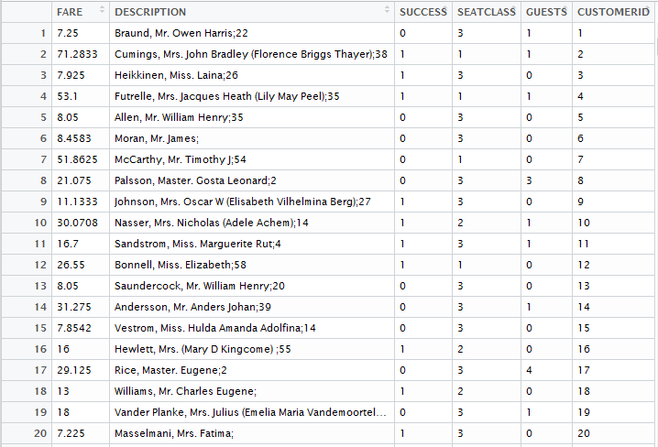

Slide 7
Metadata Extraction and Imputation
Metadata fields observed in “Description” column
First Name
Last Name
Age
Gender

Slide 8
Metadata Extraction and Imputation
Extracted the mentioned fields using R scripts (sapply, stringsplit functions)
As there is no Age data for some fields, Age field needs to be imputed with values using one of the imputing methods
Age column contains NA in most of the fields

Slide 9
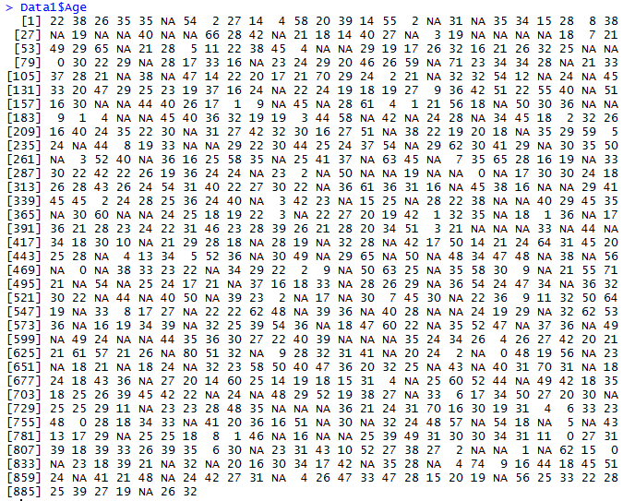

Slide 10
Metadata Extraction and Imputation
Imputation
Imputed male for “Mr.” and rest all values to female
Used mean data imputation method to replace missing “Age” values
Separated “First Name” and “Last Name” fields from “Description” column and added in the dataset as new columns
Now the data set looks like:

Slide 11
CUSTOMERID | LastName | FirstName | Gender | Age | SUCCESS | SEATCLASS | GUESTS
1 | Braund | Mr. Owen Harris | Male | 22 | 0 | 3 | 1
2 | Cumings | Mrs. John Bradley (Florence Briggs Thayer) | Female | 38 | 1 | 1 | 1
3 | Heikkinen | Miss. Laina | Female | 26 | 1 | 3 | 0
4 | Futrelle | Mrs. Jacques Heath (Lily May Peel) | Female | 35 | 1 | 1 | 1
5 | Allen | Mr. William Henry | Male | 35 | 0 | 3 | 0
6 | Moran | Mr. James | Male | 23 | 0 | 3 | 0
7 | McCarthy | Mr. Timothy J | Male | 54 | 0 | 1 | 0
8 | Palsson | Master. Gosta Leonard | Female | 2 | 0 | 3 | 3
9 | Johnson | Mrs. Oscar W (Elisabeth Vilhelmina Berg) | Female | 27 | 1 | 3 | 0
10 | Nasser | Mrs. Nicholas (Adele Achem) | Female | 14 | 1 | 2 | 1
11 | Sandstrom | Miss. Marguerite Rut | Female | 4 | 1 | 3 | 1
12 | Bonnell | Miss. Elizabeth | Female | 58 | 1 | 1 | 0
13 | Saundercock | Mr. William Henry | Male | 20 | 0 | 3 | 0
14 | Andersson | Mr. Anders Johan | Male | 39 | 0 | 3 | 1
15 | Vestrom | Miss. Hulda Amanda Adolfina | Female | 14 | 0 | 3 | 0
16 | Hewlett | Mrs. (Mary D Kingcome) | Female | 55 | 1 | 2 | 0
17 | Rice | Master. Eugene | Female | 2 | 0 | 3 | 4
18 | Williams | Mr. Charles Eugene | Male | 23 | 1 | 2 | 0
19 | Vander Planke | Mrs. Julius (Emelia Maria Vandemoortele) | Female | 31 | 0 | 3 | 1
20 | Masselmani | Mrs. Fatima | Female | 23 | 1 | 3 | 0

Slide 12
Metadata Exploration
Metadata Exploration is done using Tableau
Compared each of the metadata with Customer ID field and obtained patterns in Tableau
Each of the distribution can be seen as below:

Slide 13
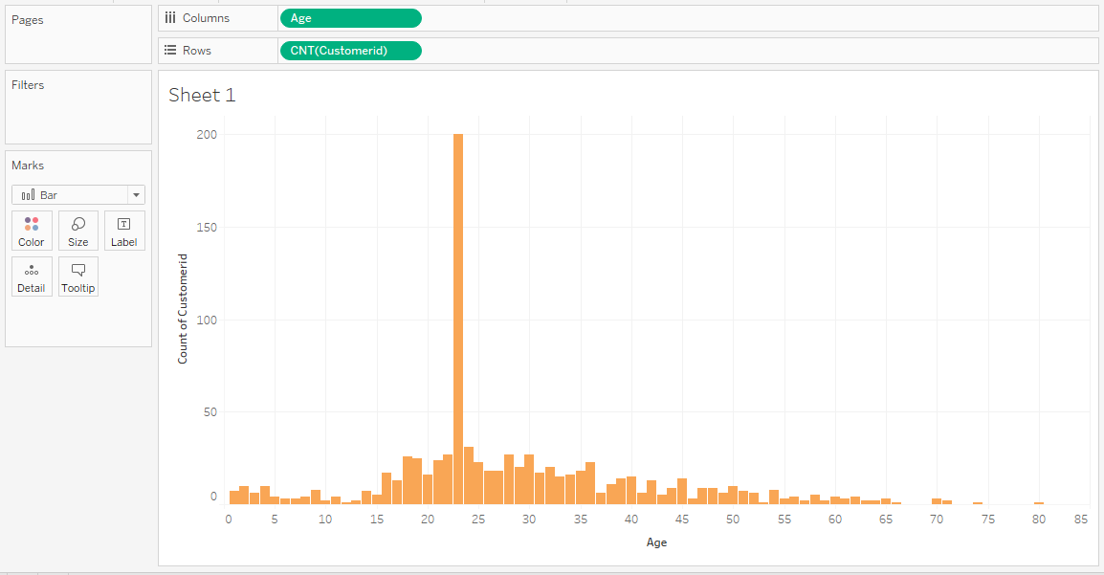
Number of Customers Vs Age
Notes:
Customers with age 23 are 200

Slide 14
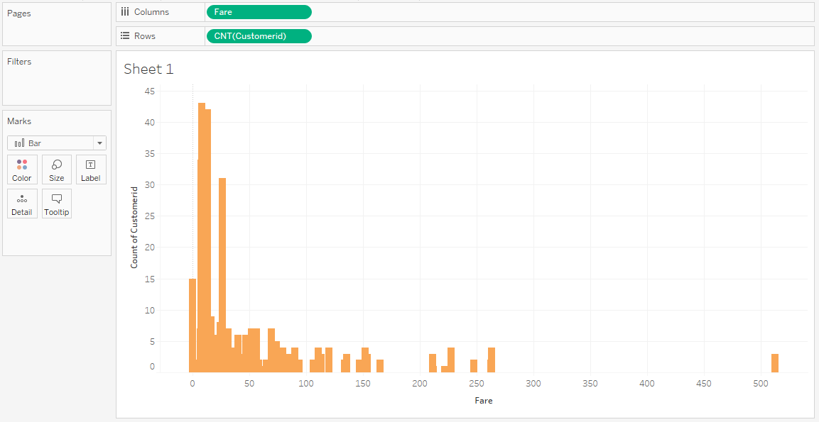
Number of Customers Vs Fare
Notes:
Customers are grouped more between the fare range of 7.8 and 26

Slide 15
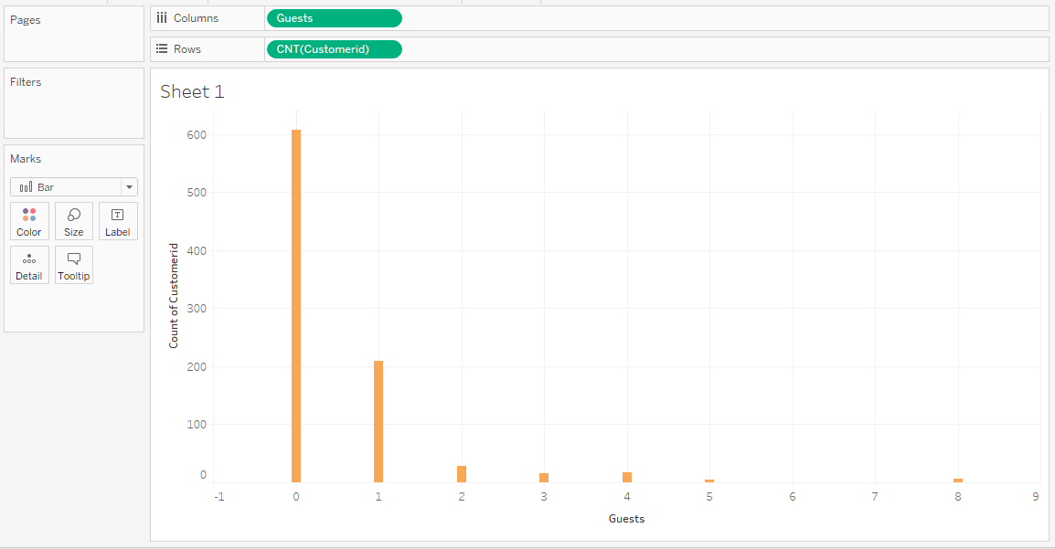
Number of Customers Vs Guests
Notes:
Number of Customers is 608 when Guests are 0

Slide 16
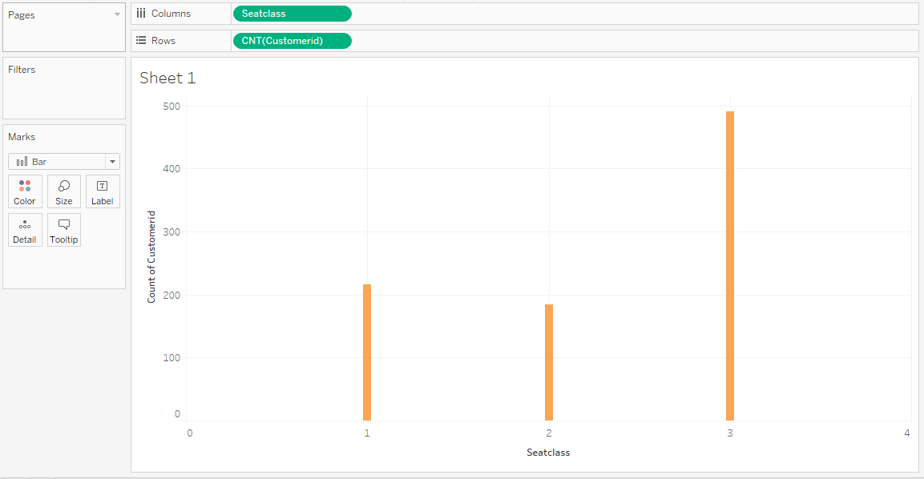
Number of Customers Vs Seat Class
Notes:
Customers with seat class 3 are 491

Slide 17
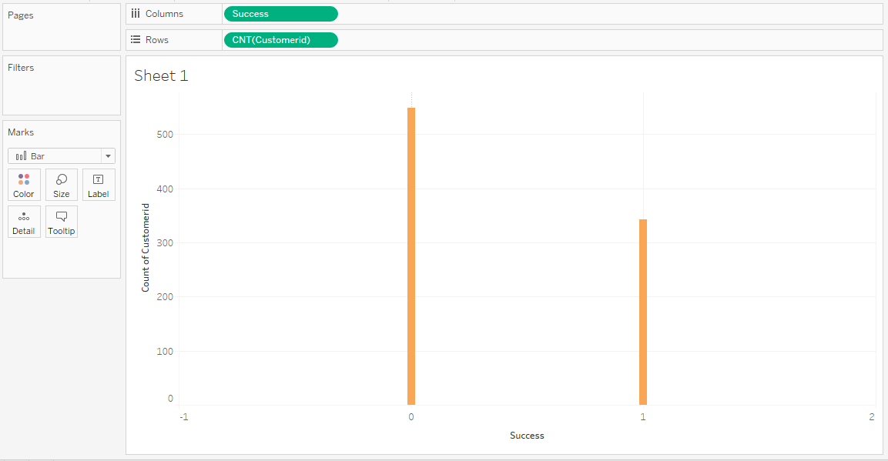
Number of Customers Vs Success
Notes:
Number of customers are 549 when success is 0

Slide 18
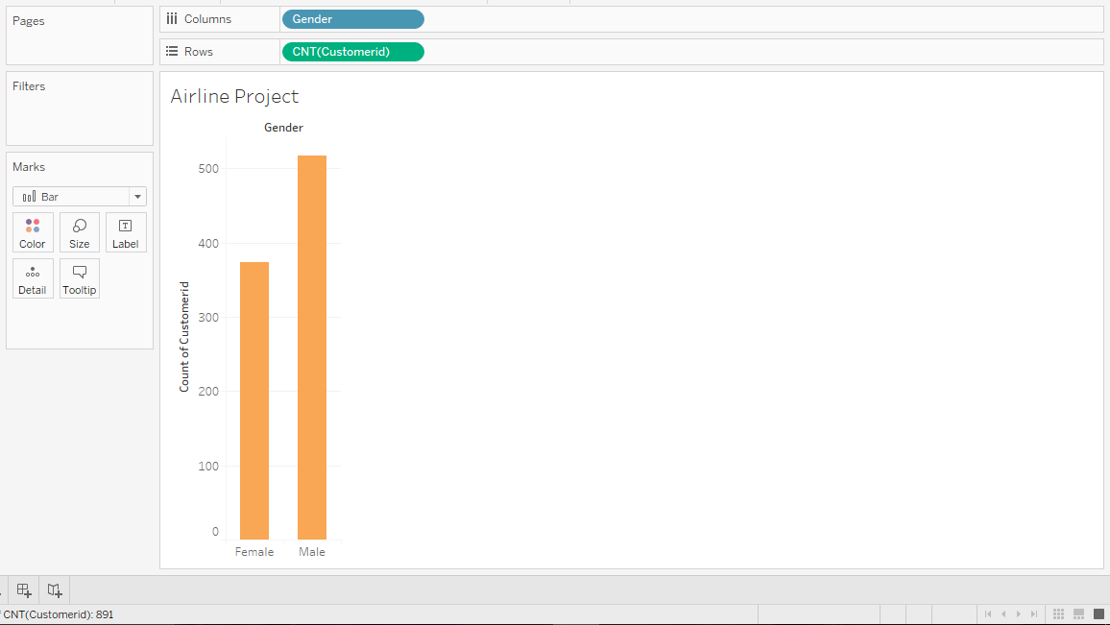
Number of Customers Vs Gender
Notes:
Number of customers are 517 when they are Male

Slide 19
Attribute Preparation and Engineering for preparing for Mining Algorithm
Attribute preparation is made using Weka tool
Imported CSV file obtained through previous steps and changed attribute type to nominal
After loading data into Weka and visualizing plots for Success and Seat Class

Slide 20
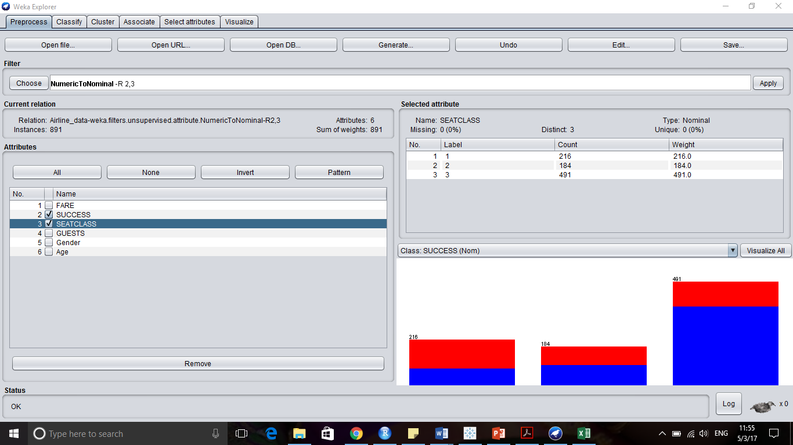

Slide 21
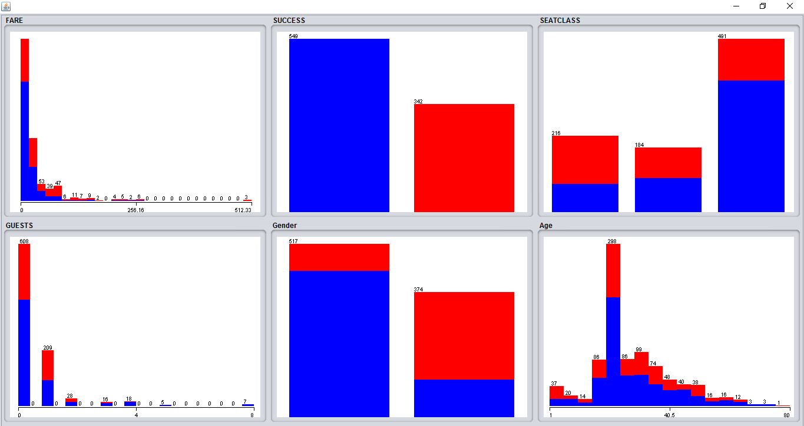

Slide 22
Attribute Preparation and Engineering for preparing for Mining Algorithm
After loading data into Weka, run attribute selection with 10 fold cross validation to get top two attributes for prediction
The results are as below:

Slide 23
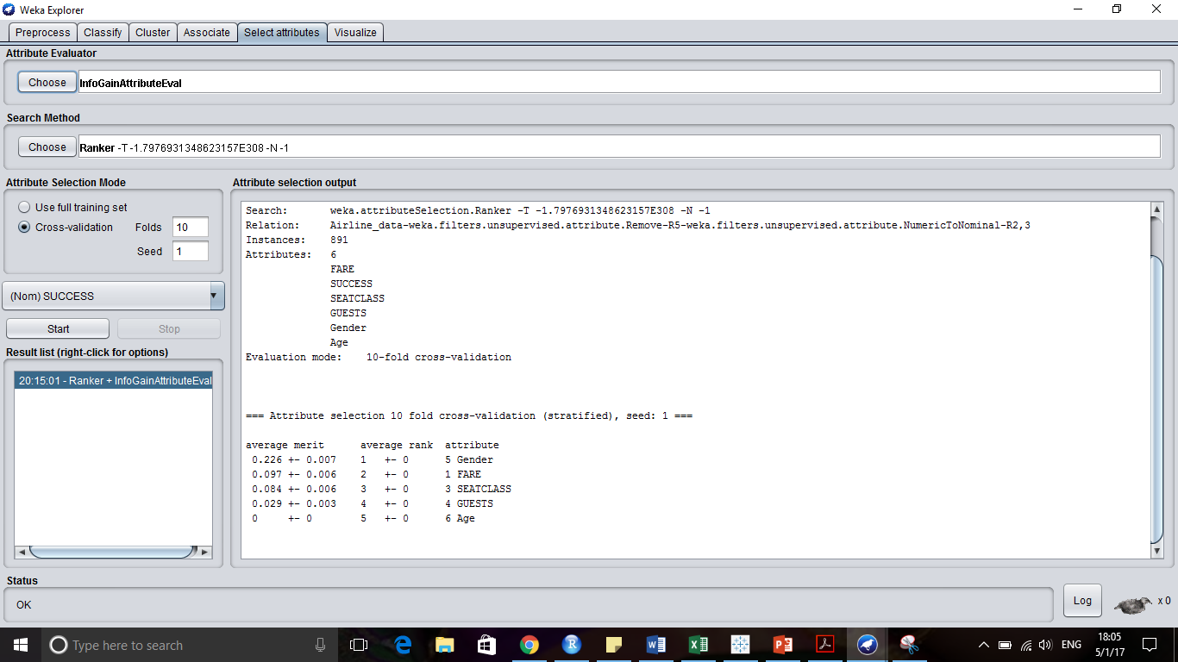
Notes:
Used InfoGainAttributeEval

Slide 24
Prediction Modeling and Visualization
Used below classification model algorithms in Weka with 80% Training data and 20% test data
Decision Tree (J48)
Random Forest

Slide 25
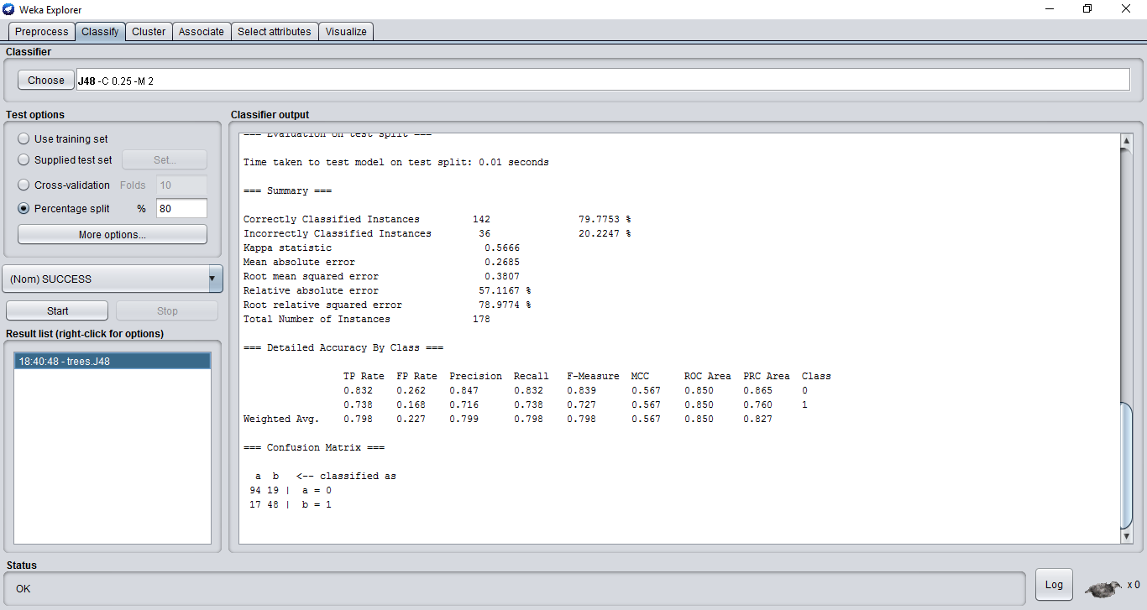
Decision Tree - J48

Slide 26
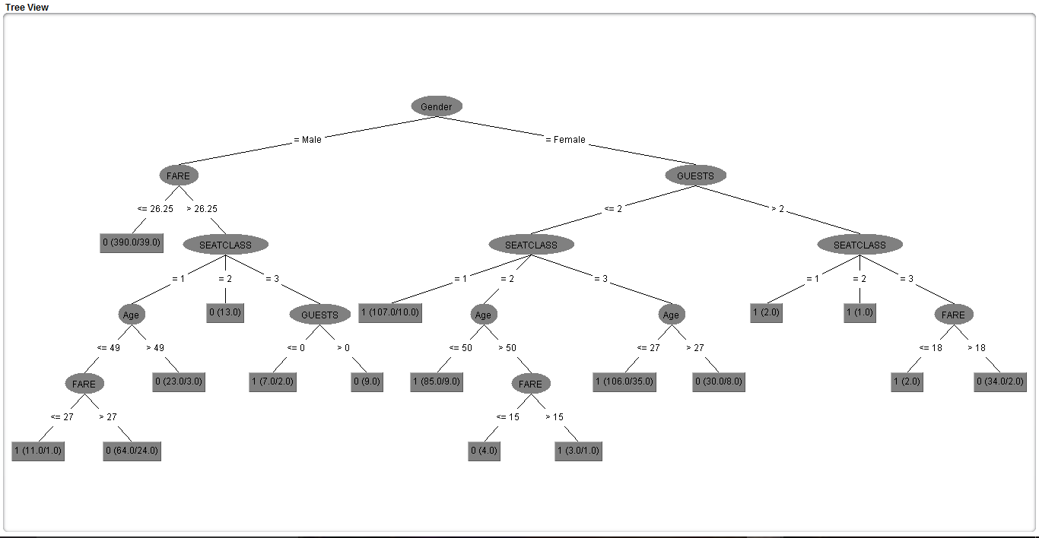
Decision Tree - J48

Slide 27
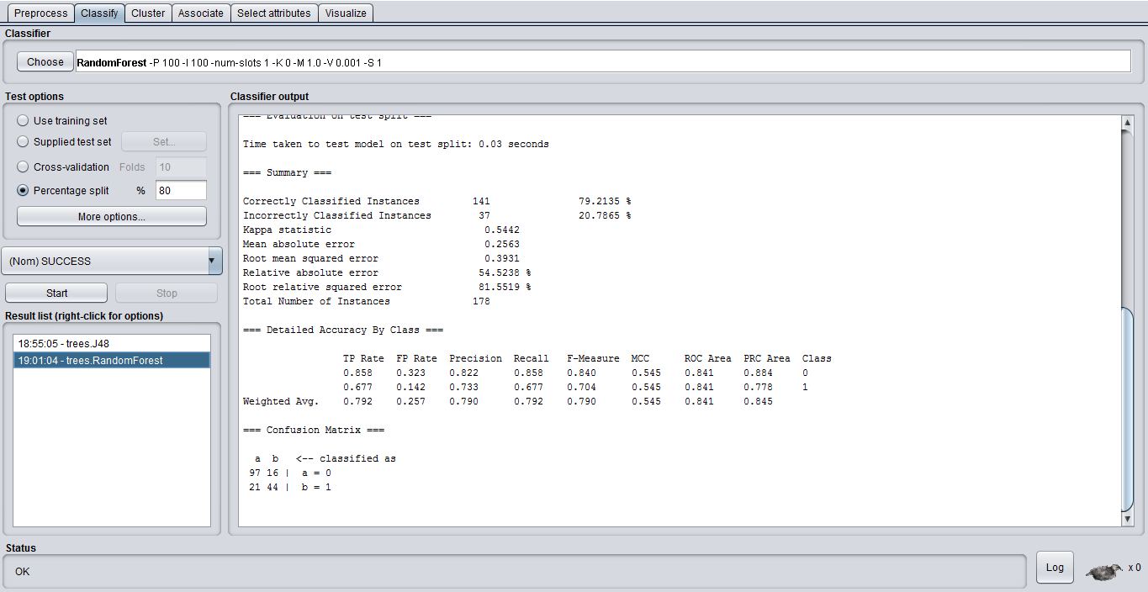
Random Forest

Slide 28
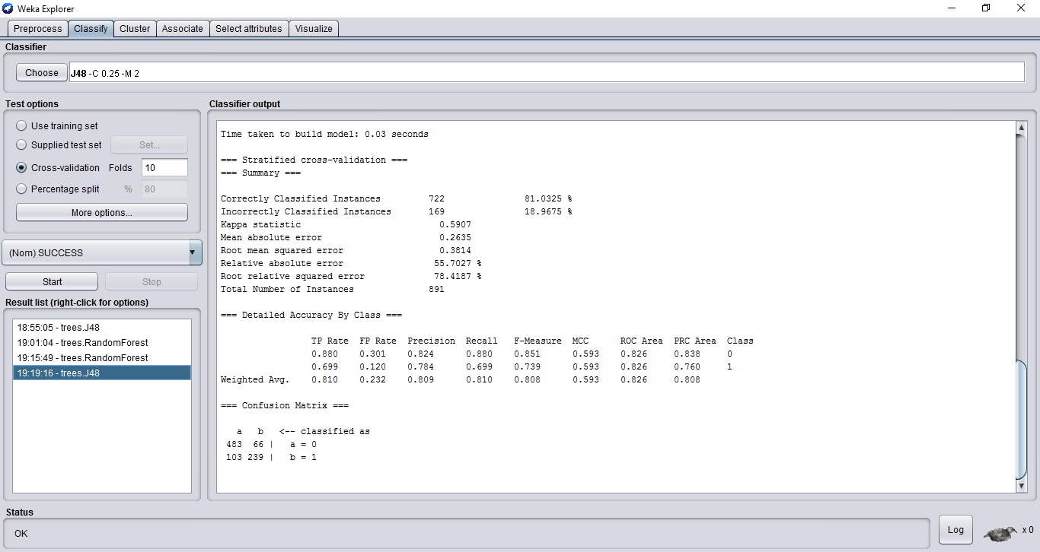
Decision Tree with 10 fold cross validation

Slide 29
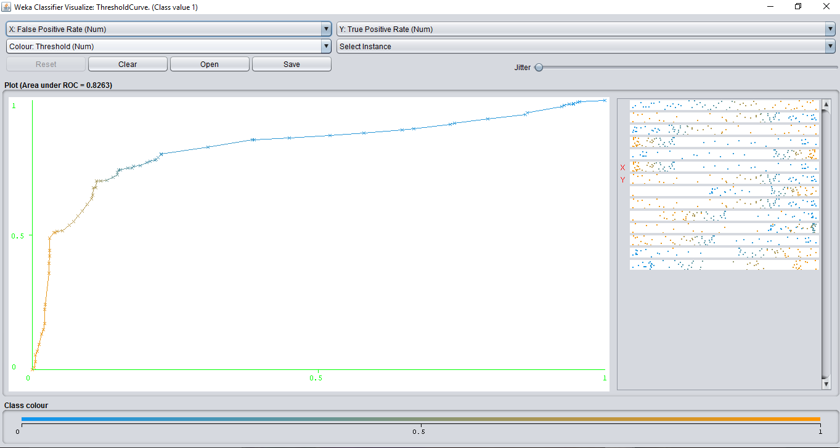
ROC curve for Decision Tree with 10 fold cross validation

Slide 30
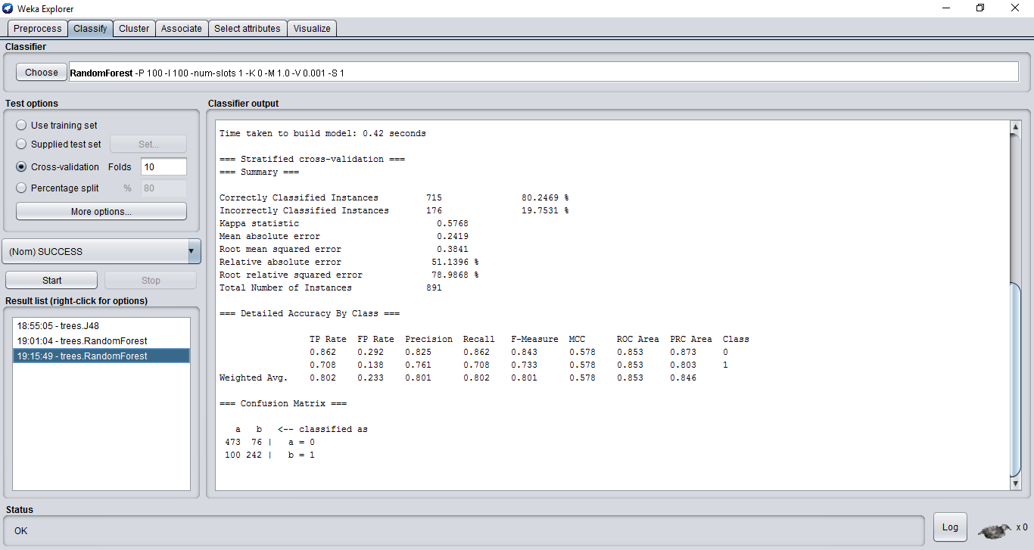
Random Forest with 10 fold cross validation

Slide 31
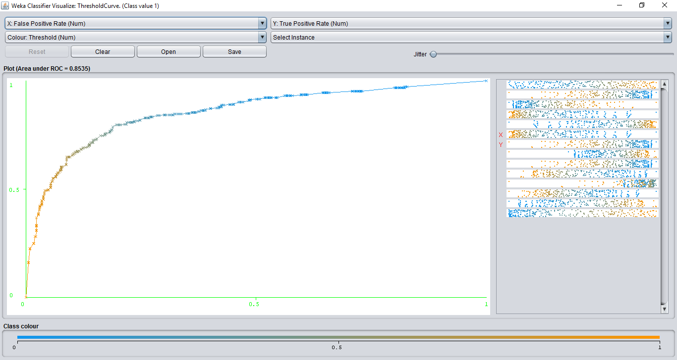
ROC curve for Random Forest with 10 fold cross validation

Slide 32

Insights
People aged around 23 travel more
01
Success rate is high with Male travelers
02
Top 2 attributes to consider are Gender, Fare
03

Slide 33
Thank you!

